Slide 1
Pre-Silicon SW/FW Testing with Protium S1 – A Case Study
Horace Chan

Slide 2
Agenda
Overview
Background
Use Model
Improvements Over Time
Roadmap
Accomplishments

Slide 3

Company Overview

Slide 4
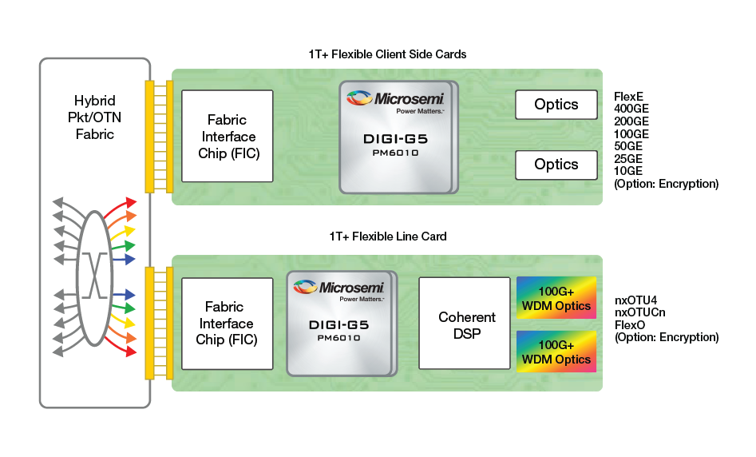
Optical Networking

Slide 5
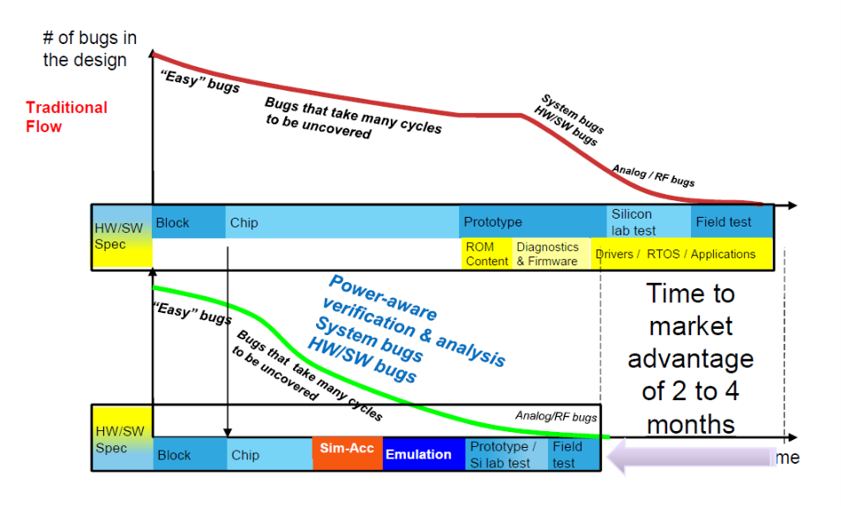
Shift Left
Start SW testing early = sooner SW release to customers
Start SW testing early =

Slide 6
History
run block level SW C code in verification testbench
TB can not keep up with the changes in the SW API
More code to test in verification
FPGA prototyping
Require RTL modification
Lack auto compilation (clock, partitioning, waveform)
Slow turn around time
Custom platform required significant development time
run full SW C code on toplevel testbench
run time is painfully slow → limited progress

Slide 7
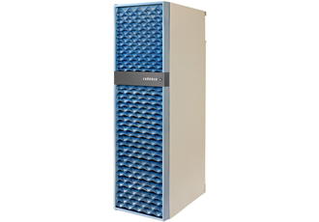
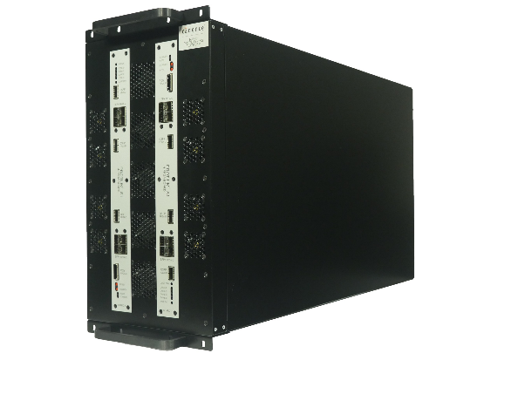
Which box?
 | Palladium Z1 | Protium S1
Cost | $$$$$$$$$$$$$$$$$$$$ | $$$
Technology | Boolean processor | FPGA
Capacity | Up to 2B gates | Up to 600M gates (3 chassis)
Compile time | 2-3 hours | 2-3 days
Waveform | Just like simulator | Require recompile*
Clock Freq | 0.5 MHz | 5 MHz
Use case | RTL debug | SW debug

Slide 8

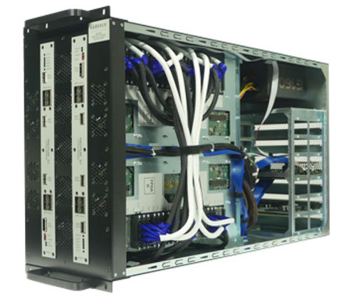
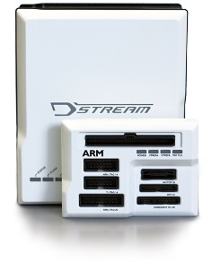
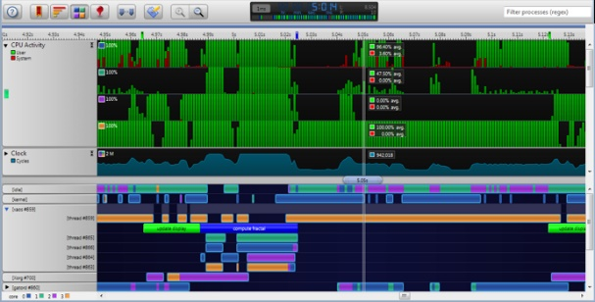
Protium S1 setup in the lab
PCIe
EDK with CentOS
(equivalent to ComExpress)
JTAG
DSTREAM probe DS-5 Studio

Slide 9

Testing SW with RTL
SW C code
FW C code

Slide 10
Improvements Over Time

Slide 11
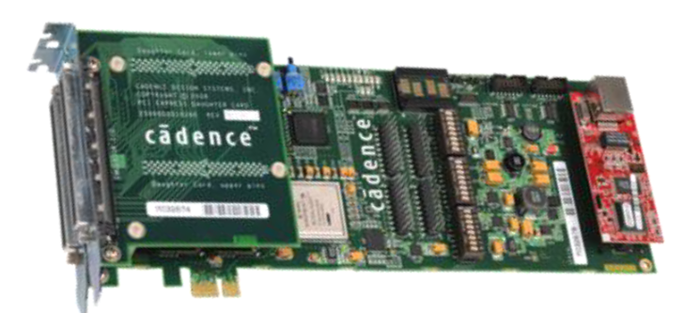
PCIe Speed Bridge
 | Gen3 SB | Gen4 SB
Clock Freq | 0.7 MHz (1 HDDC cable) 1.4 MHz (2 HDDC cables) | 5.5 MHz
Linux boot up time | > 30 minutes | < 5 minutes (CAKE2) < 2 minutes (CAKE1)
Bring up time* | 2 weeks | 1 week
* Excluding time wasted on bad hardware (SB card, IO cards, QSS cables, PTM cables, etc)

Slide 12
PnR time
PTM16.2
PnR on large builds (> 50% utilization) takes 2 weeks
PTM17.1 RTM
with hotfixes
with undocumented PnR options from Cadence R&D
with manual partition
PnR on large builds takes 3 days
Tips
Sign NDA with Cadence, so you can send all the RTL files to Cadence and let R&D debug PnR issues

Slide 13
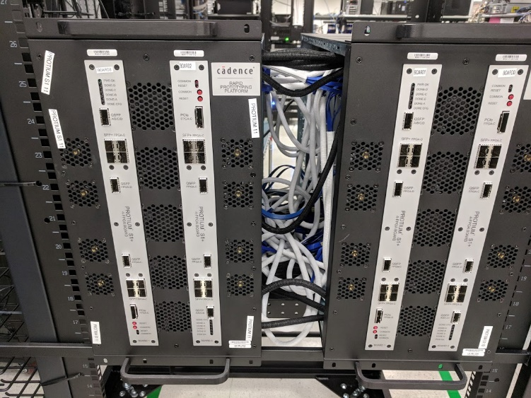
Dual Chassis setup
Trial run on beta box
Double the capacity
fits more gates
Lower FPGA utilization
much faster PnR
50-60% on 1 box takes 1 week
normal PnR than high PnR on failed FPGAs
20-30% on 2 boxes takes < 2 days
rarely requires high PnR
PTM cable configuration is not compatible with 1 chassis setup

Slide 14

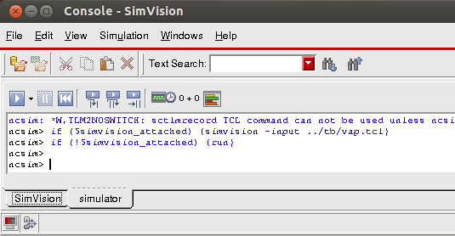
SystemVerilog Testbench over Protium
PCIe
socket
Convert AXI/APB register access into PCIe access
Run SV config sequences as-is from the testbench
Does not support any traffic gen/mon UVC
Drop in replacement of SW config API
Much easier to debug SW misconfiguration than comparing register log from simulation
SW testing is complimentary to HW verification

Slide 15
Waveform without Recompile
In PTM16.2
Changing the signal probes requires a new build & PNR
Fast, 1-2 minutes to dump 8000 cycles for 200 signals in VivadoLab
In PTM17.1
New state dump feature
change signal probes without recompile
Very slow, but still faster than a recompile
dump 8000 cycles for 200 signals takes 30 minutes
EDK/PCIe SB is dead during state dump
Use Protium assertion as trigger
changing the trigger still needs to recompile

Slide 16
Road Map
Use Protium for pre-silicon software testing on future projects
Invest in another S1 box to support dual chassis setup
Allow us to test more SW in parallel before silicon
Investigate using Protium to speed up top-level regression in verification
Protium is not the right tool to debug HW bugs
but we don’t need to debug passing simulations

Slide 17
Accomplishments
uBoot and Linux boot up
FW download
DSTEAM probe and ARM CoreSight
SW Trace Buffer
CPU profiling
All major datapath are up and running with SW
BONUS: Found 2 minor bugs in the RTL

Slide 18
Questions and Answers
Special thanks to
Markus Karg, Sreenath Yaramareddy

